Slide 1


🛡️TruthGuard AI
Securing Truth in the Digital Age.
An advanced AI-powered fact-checking and news
verification ecosystem.
PRESENTED BY
Dhruv Singh Bisht
ROLL NO
2501221530064

Slide 2

Platform Introduction
Combating Digital Misinformation
▹
Comprehensive Analysis: TruthGuard AI leverages advanced Machine Learning to identify patterns indicative of fabricated news content.
▹
Automated Fact-Checking: The platform cross-references claims against trusted sources dynamically using integrated search modules.
▹
Evidence Scoring: Assigns credibility scores to articles based on source authority and verifiable evidence.
▹
End-to-End Workflow: From raw text input to generating
detailed PDF/CSV reports with automated email dispatch.

Slide 3









System Architecture
Machine Learning Core
Verification Engine
Interactive Interface
Handles data preparation, model training workflows, and executes real-time inference to predict the probability of news authenticity.
Provides deep-dive fact-checking by extracting claims, analyzing source credibility, and computing an aggregated evidence score.
A multi-page Streamlit application serving distinct modules for dashboards, analytics, history tracking, and system configuration.

Slide 4




Machine Learning Module
Intelligent Prediction Pipeline
The ml/ directory forms the predictive backbone of the platform, utilizing processed datasets (True/Fake) to train robust models.
Key scripts include prepare_dataset.py for data cleaning, train_model.py for algorithmic learning, and predictor.py for live classification.

Slide 5



Verification Engine Workflow
Source Analyzer
Fact Checker
Evidence Scorer
Operates via source_analyzer.py to evaluate the domain origin of the news, checking against known reliable and unreliable registries.
Utilizes news_search.py and fact_checker.py to crawl the web, extracting contextual information to validate the core claims of an article.
The evidence_scorer.py aggregates ML probabilities, source trust ratings, and verified facts to output a definitive final credibility score.

Slide 6



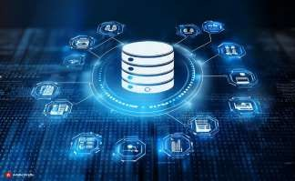


Data Storage & Reporting
Database Management
Exportable Reports
Automated Alerts
Handled by database.py, ensuring secure storage of scan histories, user settings, and known sources.
Scripts like pdf_report.py and csv_export.py allow users to download structured evidence logs.
The email_report.py module dispatches critical alerts and verification summaries to stakeholders.

Slide 7
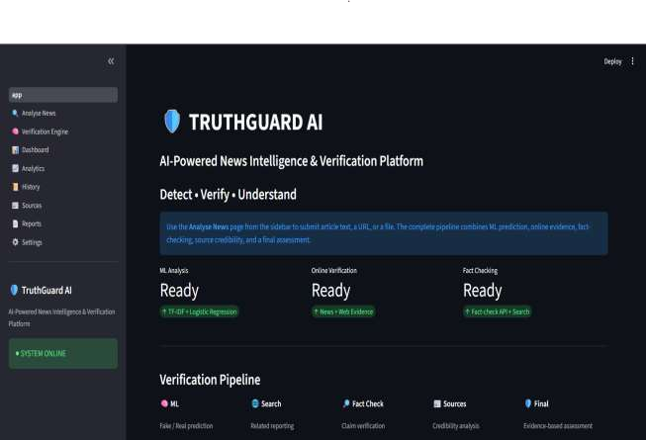

Interactive Interface
Streamlit App Architecture
The frontend is powered by Streamlit (app.py), mapped through the pages/ directory to deliver a modular user experience.
▹
Analyse News: The primary interface for text/URL input
and running instant verifications.
▹
Dashboard: A high-level view of recent activity, system
status, and quick-access tools.
▹
Analytics: Deep visual insights into processed news
trends and overall platform accuracy.

Slide 8

Supporting Modules & Utilities
Verification History (5_History.py) Maintains a searchable archive of all previously analyzed articles,
allowing users to revisit past reports and track changing narratives over time.
Source Management (6_Sources.py) An interface to manage, whitelist, or blacklist specific domains, directly influencing the Source Analyzer's trust metric.
System Settings (8_Settings.py) Exposes configuration options derived from settings.py, enabling users to tweak ML thresholds and API keys.
Core Utilities (utils/) Behind-the-scenes scripts like text_utils.py for natural language
preprocessing and ui_utils.py for consistent interface rendering.

Slide 9






End-to-End Verification Workflow
STEP 2
ML Prediction
The text is processed by predictor.py to generate a baseline probability score.
STEP 4
Report Gen
Scores are aggregated, saved to SQLite, and formatted into exportable PDFs.
STEP 1
Input & Parsing
User submits text via the UI. text_utils.py cleans the data and extracts key entities.
STEP 3
Fact Verification
The verification_engine.py searches live data and analyzes the source credibility.

Slide 10
Data Flow & Processing
Raw Datasets
The foundation of the ML model relies on vast quantities of labeled data.
Data Transformation
Raw data is never fed directly into the machine learning algorithms.
Cleaning: Removal of stop words, punctuation,
and HTML tags using the utils module.
Processing: The prepare_dataset.py script converts raw text into numerical vectors and stores them in the data/processed/ directory for efficient model training.
▹
True.csv: A curated collection of verified, factual news articles used to teach the model identifying features of reliable reporting.
▹
▹
Fake.csv: A dataset containing known instances of misinformation, satire, and fabricated claims for pattern recognition.
▹

Slide 11
Thank You
TruthGuard AI - Securing the Information Ecosystem.

